Slide 1
Ohm's Law Experiment
By: Jacob Stanley

Slide 2
The Law
Ohm's law represents the relationship between Voltage (V), Current (I), and Resistance (R) in a circuit...
V = IR

Slide 3
V
I
R

Slide 4
V = 50 Volts
Ammeter
I = 5 Amps
R = ?
Voltmeter

Slide 5
How do we find the resistance?
Use Ohm's Law, V = IR
We know that our voltage was 50 volts
We also know that our Current was 10 Amps
We can algebraically solve for R to give R = V/I
Substitute in our values -> R = 50/5
Solve -> R = 10

Slide 6
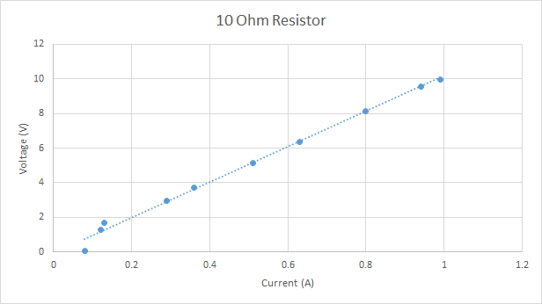
Experiment Data Gathered
Table 1. The Voltage (V), Current (I), Resistance (R) for the 10 Ohm Resistor.
Trial | V (volts) | I (amps) | R (Ohms)
1 | 0.833 | 0.08 | 10.413
2 | 1.284 | 0.12 | 10.7
3 | 1.673 | 0.16 | 10.456
4 | 2.959 | 0.29 | 10.203
5 | 3.721 | 0.37 | 10.14
6 | 5.158 | 0.51 | 10.11
7 | 6.360 | 0.63 | 10.1
8 | 8.14 | 0.80 | 10.18
9 | 9.55 | 0.94 | 10.16
10 | 9.97 | 0.99 | 10.07

Slide 7
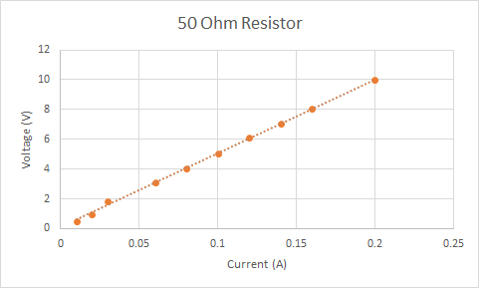
Experiment Data Gathered cont'd
Table 2. The Voltage (V), Current (I), Resistance (R) for the 50 Ohm Resistor.
Trial | V (volts) | I (amps) | R (Ohms)
1 | 0.518 | 0.01 | 51.8
2 | 0.992 | 0.02 | 49.6
3 | 1.806 | 0.03 | 60.2
4 | 3.095 | 0.06 | 51.58
5 | 4.017 | 0.08 | 50.21
6 | 5.02 | 0.10 | 50.2
7 | 6.083 | 0.12 | 50.69
8 | 7.08 | 0.14 | 50.57
9 | 8.03 | 0.16 | 50.19
10 | 9.97 | 0.20 | 49.85

Slide 8
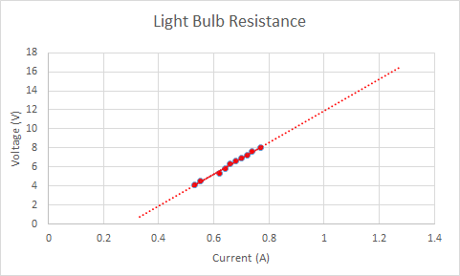
Experiment Data Gathered cont'd
Table 3. The Voltage (V), Current (I), and Resistance (R) for the Light Bulb.
Trial | V (volts) | I (amps) | R (Ohms)
1 | 4.108 | 0.53 | 7.75
2 | 4.475 | 0.55 | 8.14
3 | 5.321 | 0.62 | 8.58
4 | 5.867 | 0.64 | 9.17
5 | 6.285 | 0.66 | 9.52
6 | 6.62 | 0.68 | 9.74
7 | 6.92 | 0.70 | 9.89
8 | 7.23 | 0.72 | 10.04
9 | 7.67 | 0.74 | 10.36
10 | 8.00 | 0.77 | 10.39

Slide 9
What to take away from this experiment
Ohm's Law shows the relationship V = IR
Knowing the voltage and the current allows the calculation of resistance
With a constant resistance, if voltage increases, so must current. (The inverse is also true)
V = IR -> V = IR
Graphing Voltage on the Y axis and Current on the X axis gives a line of best fit of which the slope is equivalent to the resistance.

